Slide 1

Data Analysis Essentials
Cornerstone Project
CYBERSECURITY INCIDENT ANALYTICS
Analyzing Cybersecurity Incidents Using Data Analytics
Presented by
D.Bhavani (26B21CS156)
U.Varma (26B21CS135)
B.Ashajyothi(26B21CS163)
P.G Malaya Sri (23B91CS148)
Guide: Mr. K. Ashok Teja, Assistant Professor, CSE Dept.
Department of Computer Science and Engineering

Slide 2




Contents
Problem Understanding
Introduction
Current/Manual Approach & Limitations
Proposed Approach
Dataset Description
Requirements
Methodology — 8 stages
Data Visualization
Additional Visualizations
Key Insights & Analysis
Implementation Workflow
Conclusion

Slide 3
PROBLEM UNDERSTANDING
Cybersecurity incident datasets contain multiple attributes such as attack type, target industry, financial loss, affected users, and resolution time.
Raw incident records are difficult to interpret directly.
Data may contain invalid values, duplicates, or inconsistent records.
A structured analytics workflow is required to transform raw data into meaningful information.

Slide 4
Introduction
Cybersecurity incidents can be analyzed using historical data to understand recurring patterns.
The project analyzes attack types, target industries, attack sources, financial losses, affected users, and incident resolution time.
Python libraries such as Pandas, NumPy, and Matplotlib are used for data processing and visualization.
The project produces cleaned datasets, summary tables, visualizations, analysis results, and key findings.

Slide 5
Current / Manual Approach
Current / Manual Approach
Incident data may be stored as raw CSV or table records.
Manual inspection makes category-wise comparison difficult.
Raw tables are difficult to interpret without visualizations.
Repeated filtering and calculations are time-consuming.
Limitations
Large datasets are difficult to review manually.
Invalid and duplicate records can affect results.
Patterns and trends are not immediately visible.
Correlation analysis requires statistical tools.
Manual processing increases the possibility of human error.

Slide 6
Proposed Approach
Load and inspect the cybersecurity incident dataset.
Acquire and filter valid records.
Extract required attributes.
Validate and clean the dataset.
Aggregate data into meaningful summaries.
Perform statistical and correlation analysis.
Create visualizations.
Interpret results and document key findings.

Slide 7
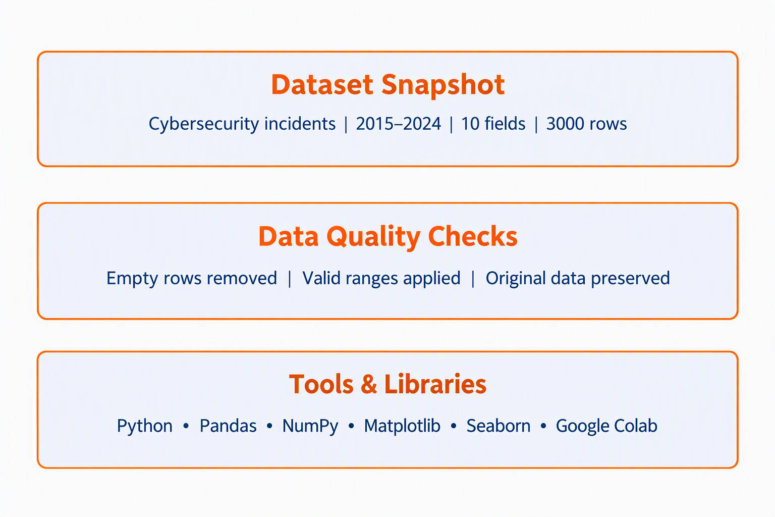
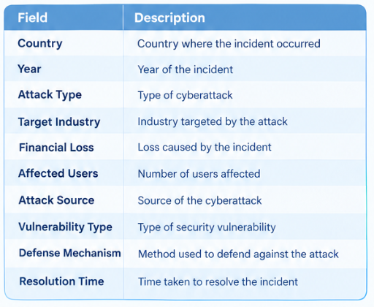
DATASET DESCRIPTION
Cybersecurity incident dataset used for project analysis

Slide 8
REQUIREMENTS
Software Requirements
Python
Pandas
NumPy
Matplotlib
Jupyter Notebook
Google Colab
CSV
Git
GitHub
Hardware / Environment
Laptop or desktop computer
Internet connection for Google Colab
Sufficient storage for datasets and project files

Slide 9
METHODOLOGY
Data Loading – We load the dataset into the system.
Data Filtering – We select only the required and valid records.
Data Extraction – We extract the columns needed for analysis.
Data Cleaning – We remove or correct missing, duplicate and invalid data.
Data Aggregation – We summarize the data category-wise.
Data Analysis – We analyze patterns ,trends and correlations in the data.
Data Visualization – We create charts and graphs to present the result clearly.

Slide 10
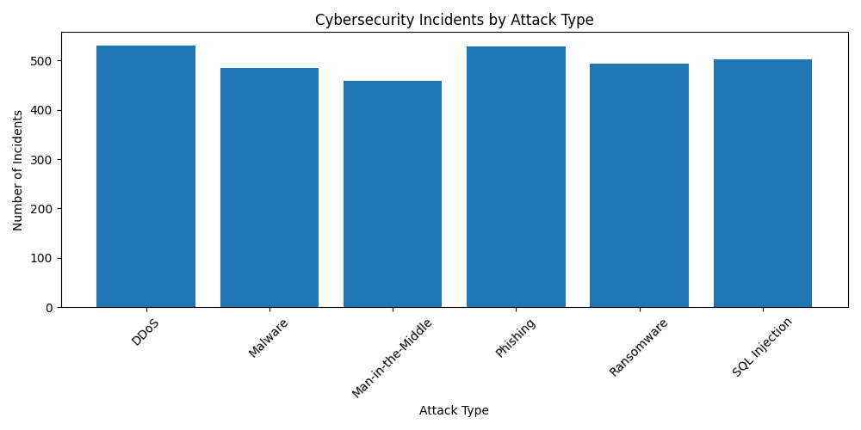
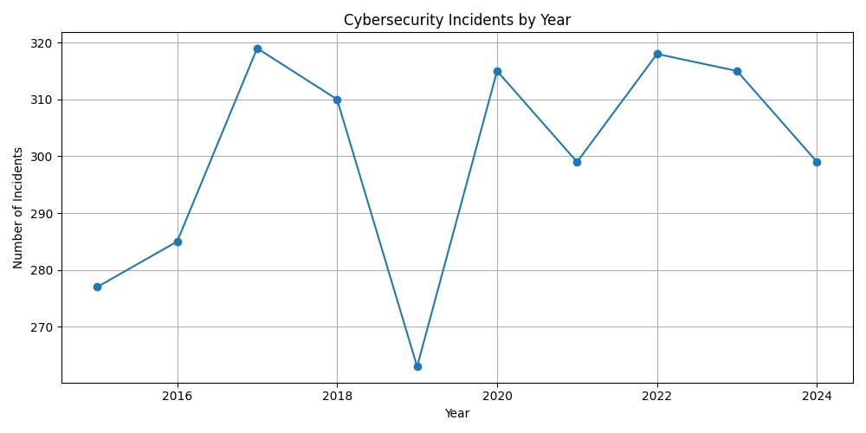
Data Visualization
Illustrative sample charts — regenerate these using your own project's data

Slide 11
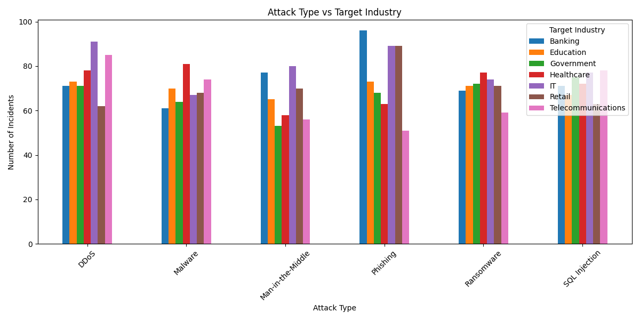
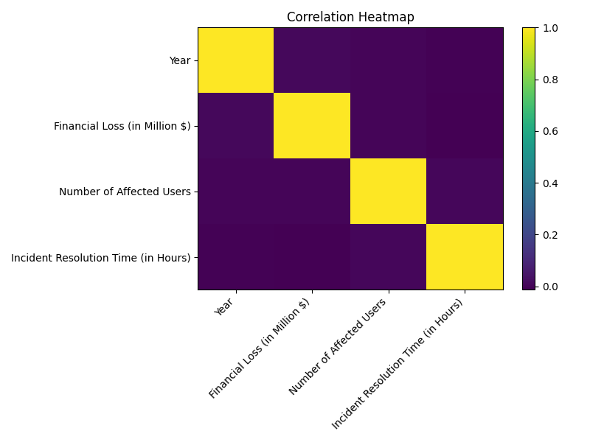
Data Visualization
Illustrative sample charts — regenerate these using your own project's data

Slide 12
Key Insights & Analysis
.
Finding | Result
Most Common Attack Type | DDoS
Most Targeted Industry | IT
Year With Most Incidents | 2017

Slide 13
CONCLUSION
The project implements a complete cybersecurity data analytics workflow.
The dataset was loaded, filtered, extracted, validated, cleaned, aggregated, analyzed, visualized, and interpreted.
The analysis identifies meaningful patterns in attack types, target industries, financial losses, affected users, and other incident characteristics.
Visualizations make the cybersecurity incident patterns easier to understand.

Slide 14
THANK YOU

